Slide 1
Astronomical data processing using Artificial Intelligence.
Autoencoders
S. Mirzoyan
IV Matinyan Workshop, 8-10 January, Yerevan, Armenia

Slide 2
Galaxies Data Set
EFIGI catalogue of 4458 nearby galaxies
EFIGI catalogue, a multi-wavelength database specifically designed to densely sample all Hubble types.
The catalogue merges data from standard surveys and catalogues (Principal Galaxy Catalogue, Sloan Digital Sky Survey, Value-Added Galaxy Catalogue, HyperLeda, and the NASA Extragalactic Database) and provides detailed morphological information.
Imaging data were obtained from the SDSS DR4 in the u, g, r, i, and z bands for a sample of 4458 PGC galaxies, whereas photometric and spectroscopic data were obtained from the SDSS DR5 catalogue.

Slide 3
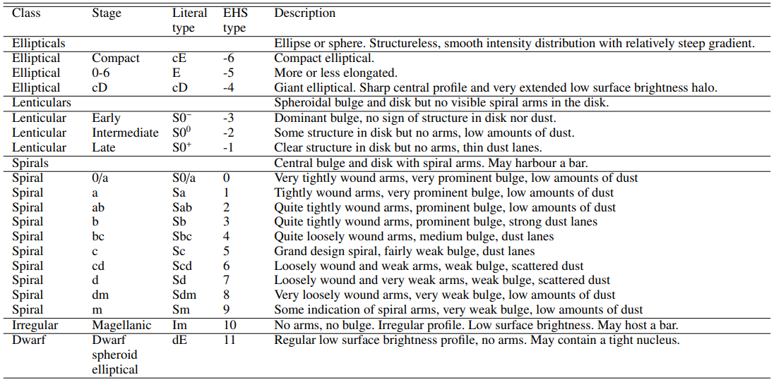
Galaxies Data Set
EFIGI catalogue of 4458 nearby galaxies

Slide 4
EFIGI Attributes
Appearance: inclination/elongation
Environment: multiplicity, contamination
Bulge: B/T ratio
Spiral arm properties: arm strength, arm curvature, rotation
Textural aspect: visible dust, dust dispersion, flocculence, hot spots
Dynamical features: bar length, inner ring, outer ring, pseudo-ring, perturbation
Baillard et al. 2011

Slide 5
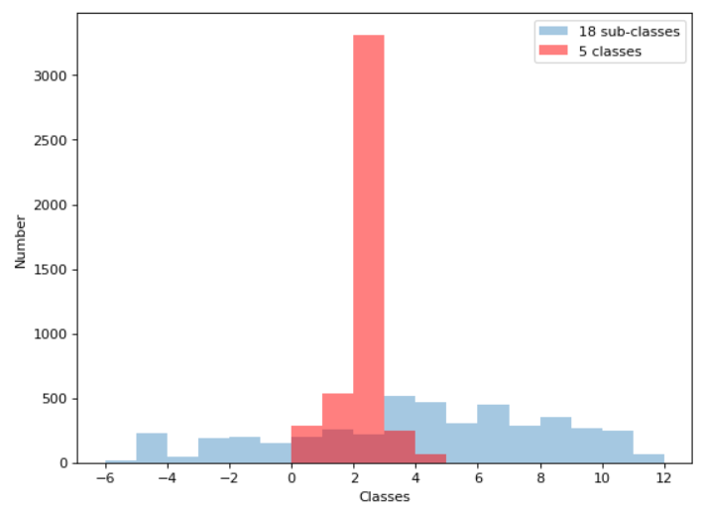
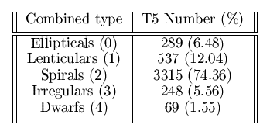
Galaxy Distribution

Slide 6
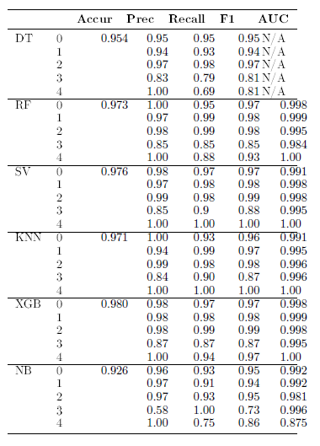
Previous Results for ML algorithms
The best classification accuracy of 98% was reached for XGB algorithm. Although all the algorithms show more or less comparable results.

Slide 7
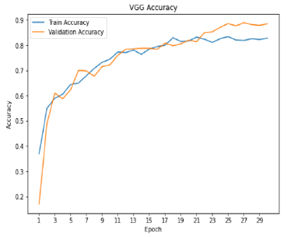
Previous Results for Deep Learning approach
Custom architecture provided about 71% accuracy, while VGG16 achieved 82.3% classification accuracy.

Slide 8
Results, Problems and dealing with them
The best DL model provides ~82% accuracy, that are 555 incorrectly classified galaxies out of 4458.
About 58% of misclassified galaxies are those with Multiplicity and Contamination.

Slide 9
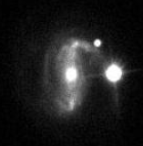
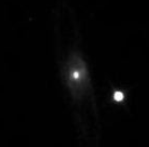
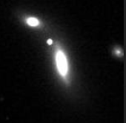
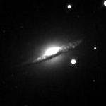
Results, Problems and dealing with them
The images used in CNN are contaminated. There are comparably large objects that are not parts of galaxies, which strongly changes the overall notion of CNN about pixel distribution.
This can be overcome by using Autoencoders - an unsupervised learning technique in which we leverage neural networks for the task of representation learning.

Slide 10
Multiplicity and Contamination
EFIGI defines the Multiplicity as a quantity describing the abundance of galaxies in the vicinity of the main galaxy. Only galaxies that have magnitudes less than that of the main galaxy plus ∼5 mag, and whose centre lies within 0.75·D₂₅ from the image centre are counted.
EFIGI defines the Contamination the severity of the contamination by bright stars or image artifacts (diffraction spikes, star halos, satellite trails, electronic defects etc).
Only 1337 images out of 4458 are not contaminated (no satellite galaxies, bright stars, image artifacts, etc.)

Slide 11
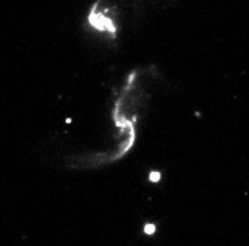
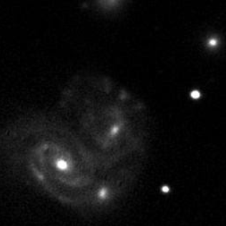
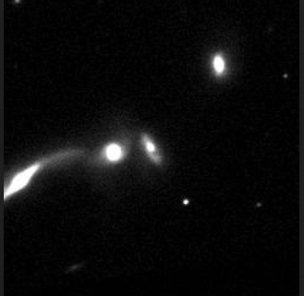
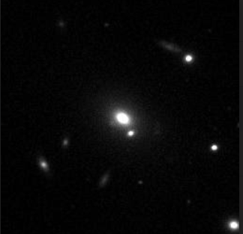
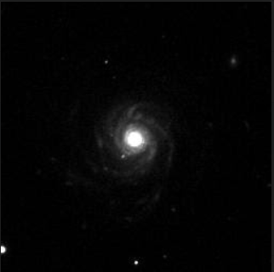
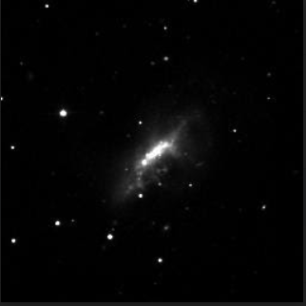
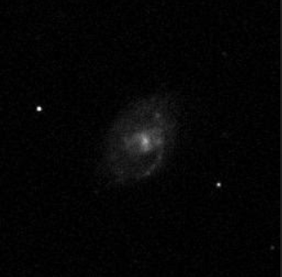
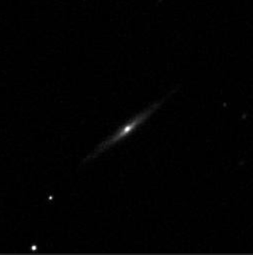
Multiplicity variety

Slide 12
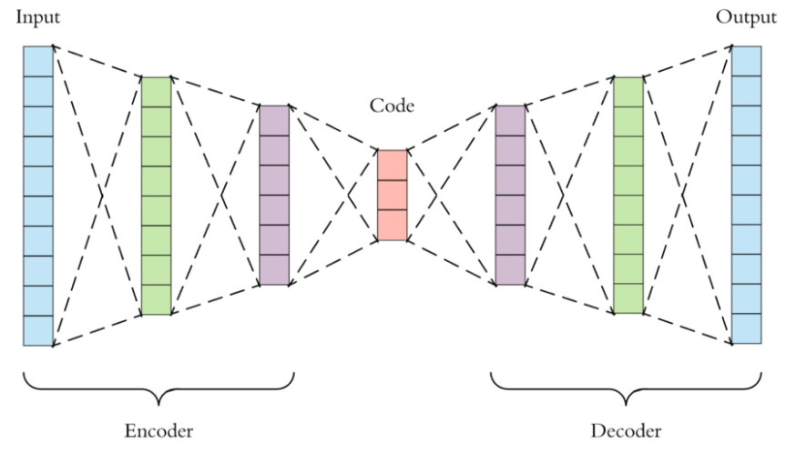
Autoencoders
Autoencoders are an unsupervised learning technique leveraging feedforward neural networks where the input is the same as the output. They compress the input into a lower-dimensional code and then reconstruct the output from this representation.

Slide 13
Autoencoders
Autoencoders are mainly a dimensionality reduction (or compression) algorithm with a couple of important properties:
Data-specific: Autoencoders are only able to meaningfully compress data similar to what they have been trained on.
Lossy: The output of the autoencoder will not be exactly the same as the input, it will be a close but degraded representation.
Unsupervised: Autoencoders are considered an unsupervised learning technique since they don’t need explicit labels to train on. But to be more precise they are self-supervised because they generate their own labels from the training data.

Slide 14
Why Autoencoders?
Autoencoder, by design, reduces data dimensions by learning how to ignore the noise in the data.
Autoencoders for anomaly detection
Image Denoising

Slide 15
Simulation
In order to have all the possible variety of images, simulation was done using 1337 images, that are the ones without any contamination.
PyAutoLense open source package has been used for secondary galaxy simulation (https://github.com/Jammy2211/PyAutoLens/).
The galaxies superimposed on real images are simulated with the following strategy:
Random choice of light profile
Random choice of the galaxy centre
Random choice of ellipticity ratio
Random choice of intensity
Random choice of effective radius
Random choice of Sersic index

Slide 16
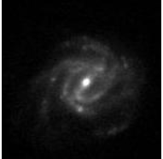
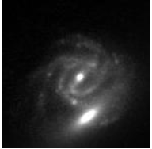
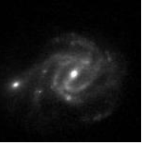
Simulation
Random number of galaxies are superimposed on each image.
Those galaxies are of different light profiles: Ell. Gaussian, Sph. Gaussian, Ell. Sersic, Sph. Sersic, Ell. Exponential, Sph. Exponential, Ell. DeVaucouleurs, Sph. DeVaucouleurs.
--->>>

Slide 17
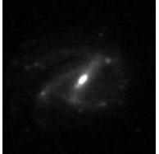
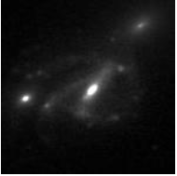
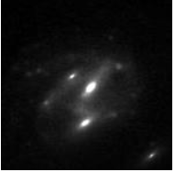
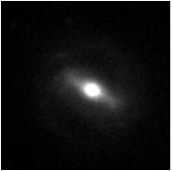
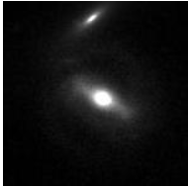
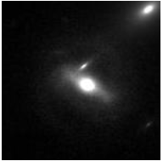
Simulation
--->>>
--->>>

Slide 18
Simulation
More than 5k simulated images, each of 150x150 pixels size.
Original images contain all types of target galaxies.
Simulated galaxies that are added to the original ones are of all above mentioned light profiles.

Slide 19
Autoencoder architecture
Encoder
4 convolutional layers with (32, 16, 8, 8) channels, correspondingly. Between those layers we apply MaxPooling layers for downsampling.
Decoder
6 convolutional layers with (64, 32, 16, 8, 8, 1) channels, correspondingly. Between some of those layers we apply Upsampling layers (4 upsampling layers).
This architecture, firstly results to dimensionality reduction of the original image size from 150x150 pixels to 14x14 pixels, preserving the important information, then increasing it up to the original size.

Slide 20
Data preprocessing
5348 simulated grayscale images of 150x150 pixel size.
Images are scaled in a way, that pixel values are within [0, 1] interval.
The whole dataset is splitted in 3 portions: train, validation and test sets, in order to avoid overfitting.
The number of each set is 4290, 758 and 300, respectively.

Slide 21
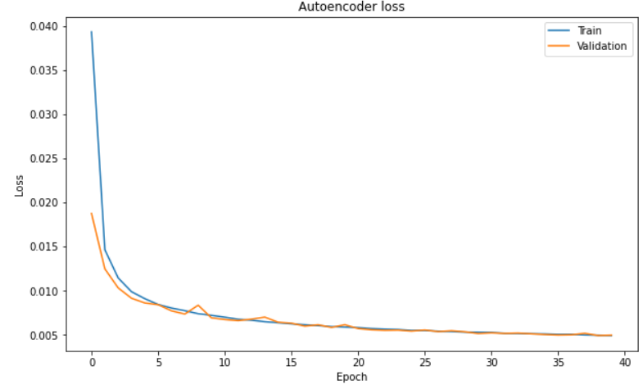
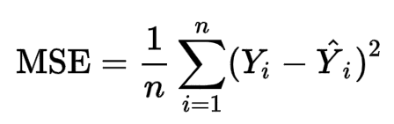
Performance quality

Slide 22
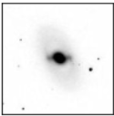
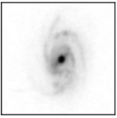
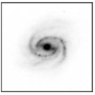
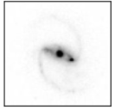
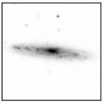
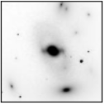
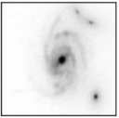
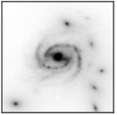
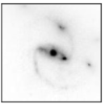
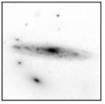
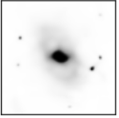
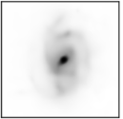
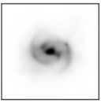
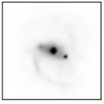
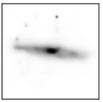
Examples
Real
Simulated
Denoised

Slide 23
Conclusion
Astronomical data processing is a very time and resource consuming process and the automation of this process can be achieved via AI, particularly using autoencoders.
Usage of denoised astronomical data helped us achieving about 90% of accuracy instead of ~82%.

Slide 24
Thank You!

